Slide 1
Machine Learning Course Project
Group 17
2050735 Li Hengxin, 2151214 Mi Tiantian,
2152050 Rao Ji, 2152667 Li Ao

Slide 2
Part 1. Background and Motivation
Acne: A common chronic inflammatory skin disease, often found in teenagers.
Effects of acne on daliy life: Acne is often associated with stress, staying up late, irregular diet and other bad habits, seriously affecting the appearance and quality of life of patients.
Treatment method: Doctors need to precisely target acne for topical treatments or laser therapy, both of which require accurate localization of the acne.

Slide 3
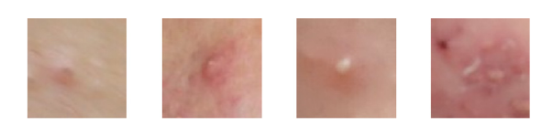
Part 1. Background and Motivation
Why we need acne localization? In clinical practice, it is laborious for dermatologists to diagnose acne grade manually. The purpose of this project is to use the method of object detection in deep neural network to solve it.
Practical significance:
Enhancing doctors' efficiency
Provide services to patients doctors
Offer more effective treatment guidance
Fig. 1. The example of four lesion (acne) images. From left to right: Comedone, Papule, Pustule, Nodule.

Slide 4
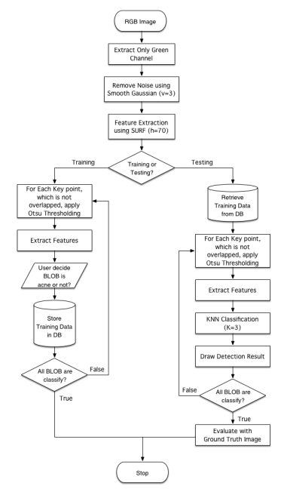
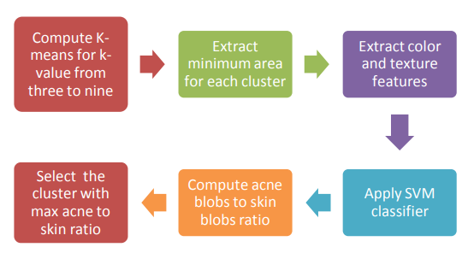
Part 2. Related Works
Conventional approaches: suffer from noise and low accuracy
Digital Assessment of Facial Acne Vulgaris
(2014 I2MTC Proceedings)
Acne Detection Using Speeded up Robust Features and
Quantification Using K-Nearest Neighbors Algorithm (2014 ICCBS)
Pipeline: Manual feature + SVM
Pipeline: SURF + KNN

Slide 5
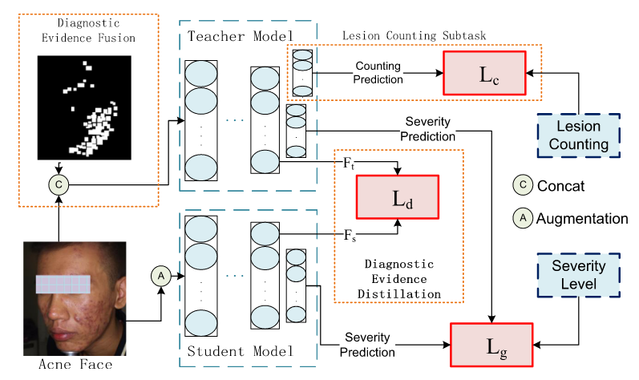
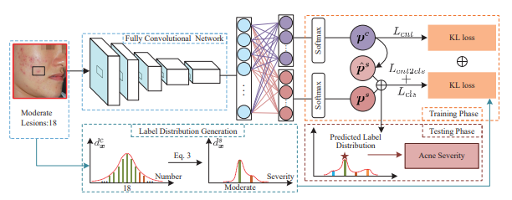
Part 2. Related Works
Deep learning-based methods: Regression, classification and segmentation tasks have many applications in medical image analysis.
Joint Acne Image Grading and Counting via Label Distribution Learning
(2019 ICCV)
DED: Diagnostic Evidence Distillation for acne severity grading on face images (2023 Expert Systems With Applications EI)
Pipeline: Counting Distribution Severity Distribution in ResNet Backbone Generating Label Distribution
Pipeline: knowledge distillation framework incorporates with joint learning for the teachernetwork

Slide 6
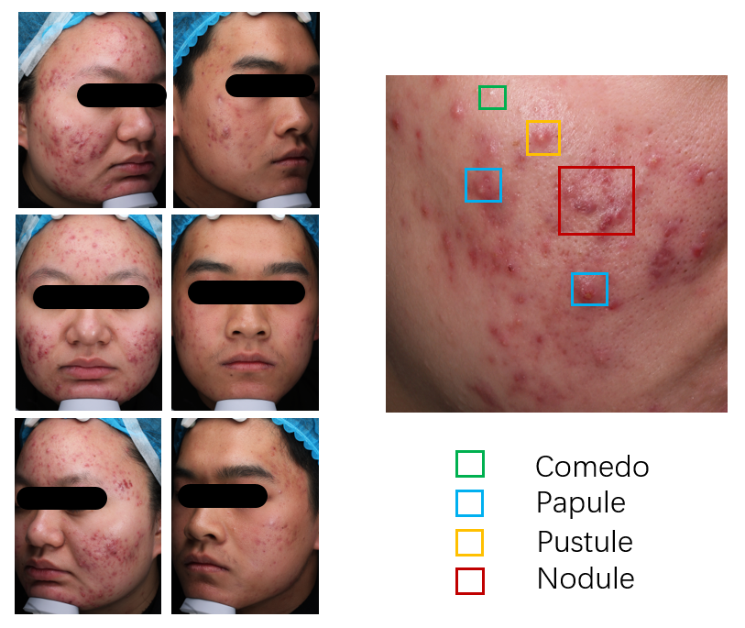
Part 3. Dataset Development
Name | images | size | classes(including background)
CelebAMask-HQ | 30000 | 512×512 | 4
Flickr-Faces-HQ | 1572 | 224×224 | -
Nestlé Skin Health | 4700 | 224×224 | 5
ACNE04 | 1457 | 3112×3456 | 5
ACNE-Shanghai | 322(309 selected) | 3456×5184 | 5
Training and Validation Dataset: ACNE04
Test Dataset: ACNE-Shanghai & ACNE04
Fig. 4. Shanghai Skin Disease Hospital Three-View Dermatoscope Image Dataset(ACNE-Shanghai). On the left are patients’ sample facial images, and on the right are labels of four categories.

Slide 7
Part 4. Model Selection

Slide 8
Part 6. References
[CCID Dataset] Quattrini A, Boër C, Leidi T, Paydar R. A Deep Learning-Based Facial Acne Classification System. Clin Cosmet Investig Dermatol. 2022;15:851-857 https://doi.org/10.2147/CCID.S360450
[ACNE04 Dataset] Wu, Xiaoping, Ni, Wen, Jie, Liang, Lai, Yu-Kun, Cheng, Dongyu, She, Ming-Ming, & Yang, Jufeng. (2019). Joint Acne Image Grading and Counting via Label Distribution Learning. In *IEEE International Conference on Computer Vision*.
[Nestlé Skin Health Dataset] https://github.com/microsoft/nestle-acne-assessment
[Flickr-Faces-HQ Dataset] https://github.com/HuynhThanhQuan/skin-detective

Slide 9
Part 1. Background and Motivation

